Slide 1
AI AND SOCIAL MEDIA LITERACY
by Sarah Allen
Humanities/Philosophy Departments
Dawson College, 2021

Slide 2
Critical Thinking and Social Media Literacy: Questions
What are they?
How do they work?
Who is in control?
How are they beneficial and/or harmful?
How can we use and regulate them properly?

Slide 3
Social Media: What are they?
Virtual socializing
Entertainment
News and information
Advertising
Goals?:
Social connection
Profits

Slide 4
Social Media: How do they work?
Lack of transparency
Surface:
Personalized feed (“intimacy of design”)
User preferences and community
Depth:
AI-powered data collection
algorithms optimizing user engagement for business profits

Slide 5
What is AI and how does it work?
computer programs using algorithms to filter data and select relevant information according to programmer goals
algorithm: formula/recipe for achieving goal set by programmer
training by data set
machine-learning: computer program learns how to optimize recipe for goal achievement over time
examples of AI in our everyday lives?
“The Story of Social Media Algorithms: A Timeline” (Ashley Hodgson, ~18 minutes)

Slide 6
SOCIAL MEDIA: ADDICTION BY DESIGN?
persuasive technology: “technology created specifically to change its users’ opinions, attitudes, or behaviors to meet its goals” (Center for Humane Technology)
Behavioral science, gaming, and marketing techniques:
operant conditioning and variable rate reinforcement (slot machine)
real-time repetitive A/B testing (lab rats)
removal of natural stops (friction)
build incredibly effective models for predicting and influencing human behaviour (surveillance capitalism)
By Jeff Kubina from the milky way galaxy - Slot Machine, CC BY-SA 2.0,
https://commons.wikimedia.org/w/index.php?curid=3946922

Slide 7
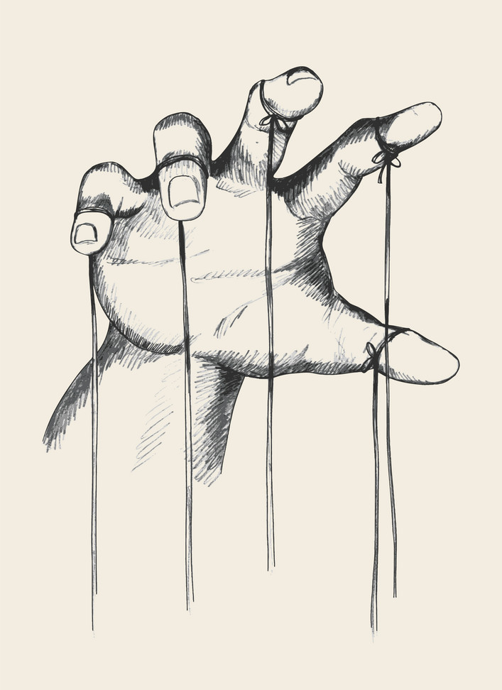
Social Media: Who is in control?
Users?
A handful of social media executives?
AI?
Algorithms with unintended consequences
Power beyond human capacity to fully grasp
Asymmetry of power:
Goals of users and companies do not coincide
AI vs. individual human

Slide 8
Social Media: How are they harmful or beneficial?
Small Group Discussion Activity:
Tristan Harris describes social media as “simultaneous utopia and dystopia” in The Social Dilemma.
What do you think he means by that?
Based on your previous reflections on your own social media use, make a list of the potential harms and benefits of social media. Think about these both in relation to your own life and to our society as a whole.

Slide 9
Social Media: harms and benefits for knowledge
Social media and knowledge accessibility?
Effects of social media algorithms on what counts as knowledge:
Algorithmic feed personalization = different “facts”, different realities
Fake news spreads faster than true news
Social media companies and their algorithms don’t have the gold standard of truth, so how to deal with the spread of falsehood on their platforms?
Can better algorithms solve these problems?
Addictive design and relation to other sources of potential knowledge
Scepticism and critical thinking about information on social media

Slide 10
Social Media: How can we use and regulate them properly?
Small Group Discussion Activity
What are some ways you can manage your own social media use in order to enhance the benefits and decrease the potential harms of social media?
What solutions does Deibert consider to the problems posed by social media?

Slide 11
DEIBERT: RESET. Reclaiming the Internet for Civil Society (2020)
quick rise of surveillance capitalism (Shoshana Zuboff)
smartphones as “toxic addiction machines”
surveillance and the abuse of power
environmental costs of digital technology
solutions for better navigating problems with digital technology

Slide 12
DEIBERT ON SOLUTIONS: THE FOUR Rs
Retreat:
Taking breaks
Digital tech-free spaces
Limits of disconnecting
Reform:
Business (corporate social responsibility, ethical design, tech fixes)
Public (media literacy, civic education)
Governmental regulation (data privacy, algorithmic accountability)
Reset:
Need of guiding ethical and political framework
Restraint:
Limitation of power & self-control
Foundational principle
Liberalism & Republicanism

Slide 13
SMALL GROUP ACTIVITY
Deibert proposes we reset our approach to, and regulation of digital technology using the principle of restraint central to liberalism.
What ethical and/or political principles would you like to see at work in a guiding framework for how digital technology is designed and used in our society? What social values and goals do you think such a framework should promote?

Slide 14
RESOURCES
Alter, Adam. Irresistible. The Rise of Addictive Technology and the Business of Keeping us Hooked. Penguin, 2017
Harris, Tristan, Aza Raskin, Randima Fernando, Center for Humane Technology:
The Social Dilemma (Netflix documentary)
Your Undivided Attention (pod cast)
Toolkits
Deibert, Ronald J. Reset. Reclaiming the Internet for Civil Society. CBC Massey Lecture. Anansi, 2020.
Fogg, B. J. Persuasive Technology. Using Computers to Change What We Think and Do. Morgan Kaufmann, 2003.
Weinberger, David. Too Big To Know. Rethinking Knowledge Now That the Facts Aren't the Facts, Experts are Everywhere, and the Smartest Person in the Room is the Room. New York: Basic Books, 2011.

