Slide 1
AI and ML Primer

Slide 2
Agenda
What is Intelligence?
What is Artificial Intelligence?
Machine Learning
Learning is Training. How do machines model the world around us?
Classification vs Regression.
Types of ML

Slide 3
Data Analysis
Dataset: large groups of separate but related information.
For example the following might be a dataset of marathon times.
What can we do with this data? Try and predict people’s marathon times? Predict if someone is a smoker or not?
Age | Height | Smoker | # of Past Marathons | Marathon Time
32 | 1.8m | Yes | 0 | 4.8h
19 | 1.6m | No | 3 | 4h
65 | 1.4m | No | 4 | 5h

Slide 4
Suppose we had a list of points with two features (x and y)
Without any analysis this is just a scatter of data!

Slide 5
By finding the fit we can determine if there is a correlation between two variables.
Using stats we can also determine how good this fit is. (The r-value)
If an increase in x corresponds to an increase in y, then x and y are
positively correlated.
If an increase in x corresponds to a decrease in y, then x and y are negatively correlated.

Slide 6
By adding labelled Axis we now see that this data has meaning.
Here we see that Life Expectancy and Salary are Positively Correlated.

Slide 7
By adding labelled Axis we now see that this data has meaning.
Here we see that Life Expectancy and Salary are Positively Correlated.

Slide 8
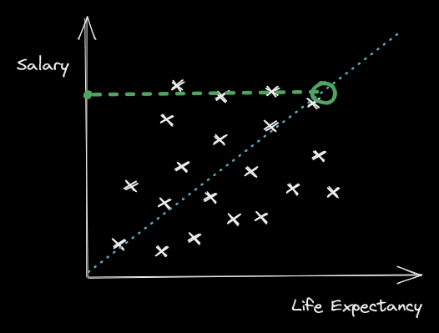
Using this fit we can then estimate the life expectancy based on someone’s salary!
This is called a regression task.

Slide 9
Correlation
Correlation: How much two variables change in a similar way.
Often computed with an R-score (no not that R-score).
R = 1.0 → Perfect Positive Correlation (increase in x = increase in y)
R = -1.0 → Perfect Negative Correlation (increase in x = decrease in y)
R = 0 → No Correlation
https://www.tylervigen.com/spurious-correlations

Slide 10
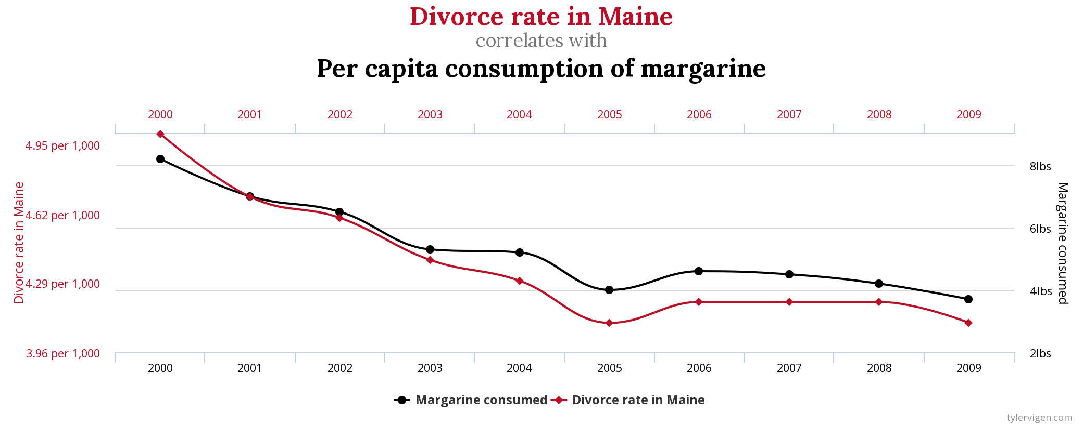
Correlation v Causation
Divorce rate in Maine is strongly correlated to consumption of margarine! (r = 0.99)
Does that mean that eating margarine causes divorce? Or vice versa?

Slide 11
Beware Misleading Graphs!
The graphs I showed before are missing some details:
No r-score on the fit line (is it actually a good fit?)
No scale/labels on the axis.
Where does this data come from? Is it a reputable source (or did James just make this data up?)

Slide 12
Without r-value we can draw the line wherever we want!!!

Slide 13
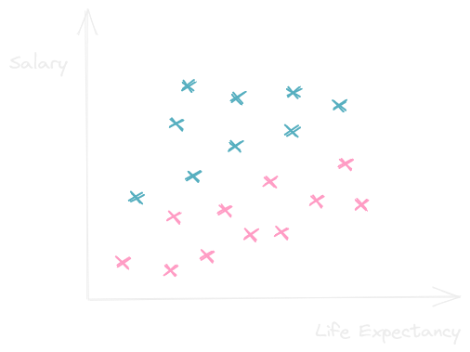
Sometimes data comes with labels!

Slide 14
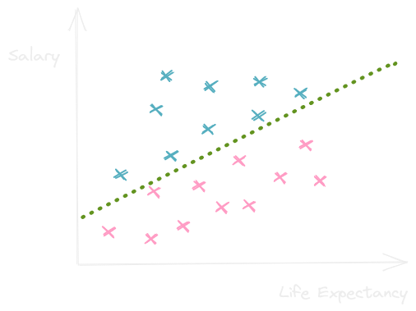
Instead of finding a fit, maybe we want to find a boundary between the two groups!
This is called a classification task.
Notice all pink labels are below the line and all blue labels are above.

Slide 15
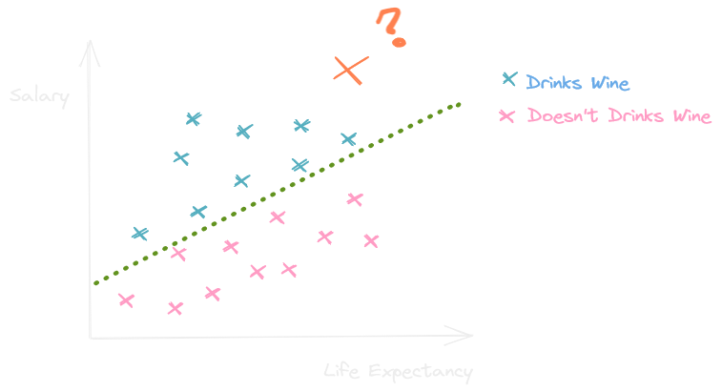
What would we label the orange x?
Wine drinker or non-wine drinker?

Slide 16
It’s not always Easy!
Sometimes there are outliers. Points of data which don’t follow the same pattern as the others.
How can we be sure that if we classify an unlabelled data point it won’t be an outlier?
This is a foundational piece of data science! How do we reduce false positives/ false negatives!

Slide 17
Types of Learning
Supervised: Learning using labelled data, leverages ground truth to teach a model.
Unsupervised: Learning using unlabelled data, finds underlying patterns, cluster groups together.

Slide 18
Training Supervised Models
Training a Model requires Data. When deciding on our model we need to ask, what kind of data do we have, what data do we want to use.
Training Set – Data we will use to train our model. This is data where the True Label is known, so we can make sure that our model is as accurate as possible.
Validation Set - Data we use to make sure our model isn’t overfitting! We don’t change the model based on this set, we only use it to get an idea of how good it is.
Test Set – Data where we don’t know the True Label. We are hoping our model does a good job now!

Slide 19
Overfitting
When we train models, we are fitting the model to the training set we use.
Overfitting is when the model works very well on the training data, but fails in reality. The model doesn’t generalize well!
Validation sets are one tool we use to prevent overfitting.
Overfitting can also occur if our training data is not representative of the actual real world distribution. If we train Facial Recognition on only White Faces, it won’t be able to predict Non White Faces accurately.

Slide 20
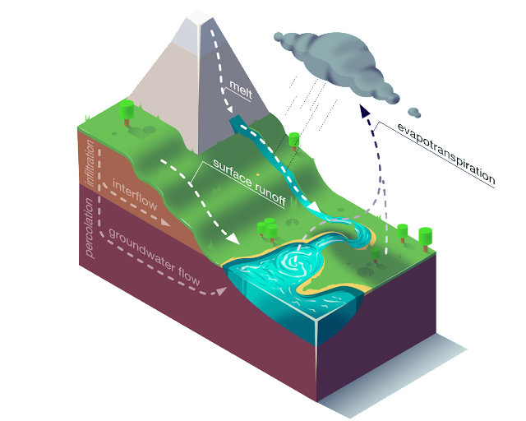
Forecasting and Prediction
Forecasting using statistics and computers has been done for many years!
Using many different variables called features we can make predictions.
Use large datasets of past events to train a prediction model.
Used for:
Weather Forecasting
Natural Disaster Prediction/Monitoring
Logistics/Scheduling
Much much more!
https://ai.googleblog.com/2019/09/an-inside-look-at-flood-forecasting.html

Slide 21
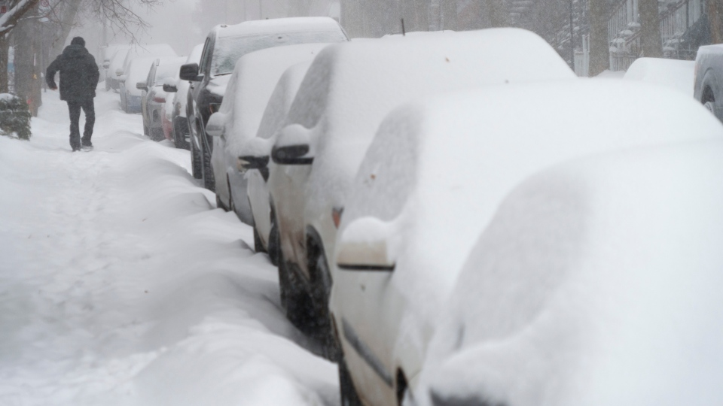
Bias
The data sets we use to build our models have a large effect on the outcome of the model.
This means that if a dataset is biased towards a specific type of feature, then we will be better at predicting for those types of features.
Example: Suppose we used data taken from Los Angeles to build a weather prediction model. Would that model work well in Montreal?
No! It doesn’t snow in LA!

Slide 22
Natural Language Processing
Another use for big data is creating models of natural language
This can be used for:
Translation
Predictive Text
Question Answering ( Think Search Engines )
Summarizing
Sentiment Analysis (Was this a good movie review or a bad movie review)
And more ☺

Slide 23
Natural Language Processing
NLP uses large datasets of language such as Wikipedia, IMDb/Amazon reviews, Tweets, or even the entire works of William Shakespeare.
These datasets aren’t always a perfect representation of language, they have biases which reflect our own social constructs.
For example if every doctor in a dataset uses he/him pronouns and every nurse uses she/her pronouns which of the following predictive text options do you think is more likely?
A. My friend is a doctor. He is very smart and good with people.
B. My friend is a doctor. She went to school for many years to achiever her goals!
Machine Learning magnifies the biases of a dataset!

Slide 24
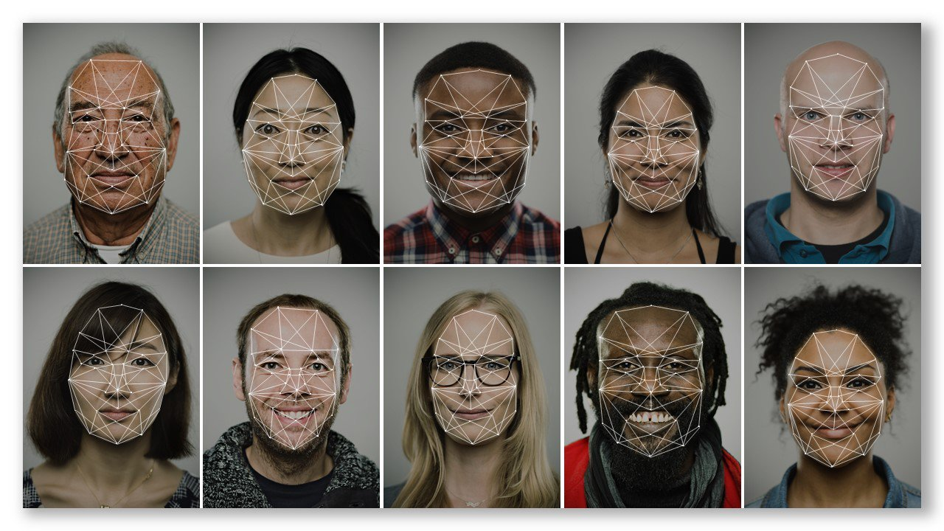
Computer Vision
Computer Vision is the study of determining what’s in an image using a computer.
This can be simple line/edge detection for a robot to navigate, or as sophisticated as face recognition.
Computer Vision is being used to monitor public streets as potential evidence in crime scenes, monitor students taking online exams, or even to predict the birth sex of a person before they can use an app.
Problem: Datasets for computer vision have been traditionally made up of predominately white male faces.

Slide 25
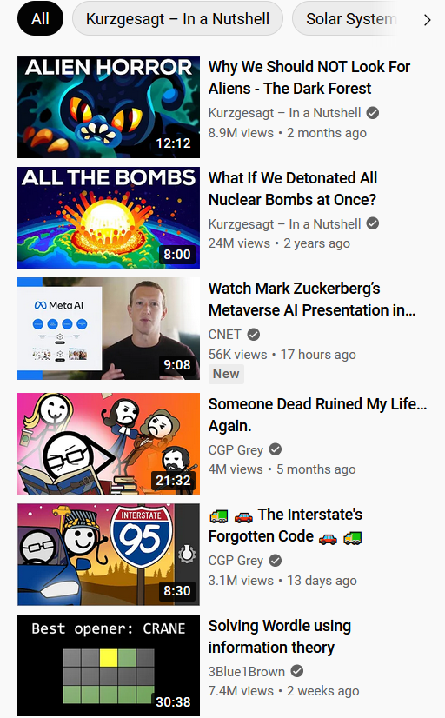
Recommender Systems
A recommender system is used to determine what other products/services a user might like based on past purchases/interactions.
Often referred to as “The Algorithm”
Used by Amazon, Netflix, YouTube, Tik Tok, Google, etc. to “curate” media for it’s users.
Bases recommendations off of users with similar interests.
What is the bias here?
Majority of users don’t belong to a minority or underrepresented group
Recommender Systems are better at recommending main stream media.
Recommendations can also be “fudged” to promote media that the platform supports, and to hide media that the platform doesn’t want to show.

Slide 26
Where does Data come from?
Many different sources: online news outlets, government documents, online encyclopedias.
Historical Data
Online News Outlets
Government Documents
Labelled Online Media ( Product Ratings, Hashtagged Social Media,…)
Some data is gathered from users! If a service is free to use, then how do they profit?
Ad Revenue.
Selling data gathered about you!
Data can also be crowdsourced, where users are paid to label data ( a single user might be unreliable, but many users will average out)

Slide 27
Summary
Classification Tasks: Using a list of features determine what category/label something belongs to.
Regression Tasks: Using a list of features determine the value of a different feature.
Bias: Datasets have bias which influence the models trained on them
Bias can be social: The bias in datasets might be caused by some social influence
Data Analysis can be used to solve a large number of tasks, but we need to be careful!

