Slide 1
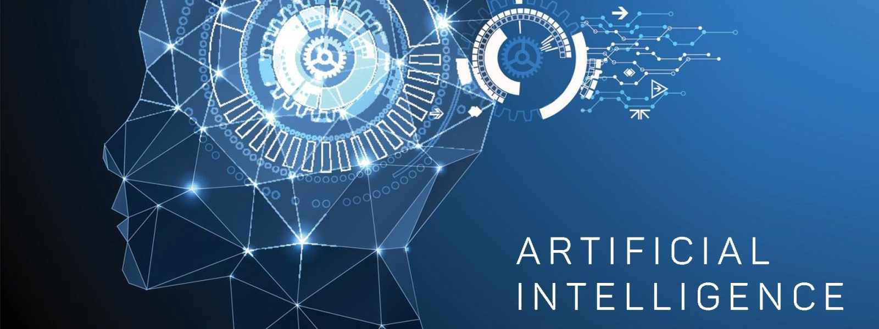
Social Problems: Sociology, Technology and Artificial Intelligence: Applying Sociological Imagination to Innovation
Image:
ghananewsonline.com
Professor: Jennifer Sigouin, PhD
AI and the Turing Test

Slide 2
Artificial Intelligence (AI)
Started as a discipline in the late 1940s, with the aim of developing tools that could resemble or outperform human intelligence.
AI is a branch of computer science dealing with the simulation of intelligent behavior in computers
Machine Learning: ability for machines to find patterns in data
“the use and development of computer systems that are able to learn and adapt without following explicit instructions, by using algorithms and statistical models to analyze and draw inferences from patterns in data” (Oxford dictionary)
General goal of AI is to simulate human faculties

Slide 3
Hard to Define: What Is AI and What Can It Do
-Data analysis
-Can AI be intelligent?
-Can AI think?
-Can AI display empathy?
The goal of AI is to replicate human faculties often including emotionality
Notes:
https://www.youtube.com/watch?v=3wLqsRLvV-c

Slide 4
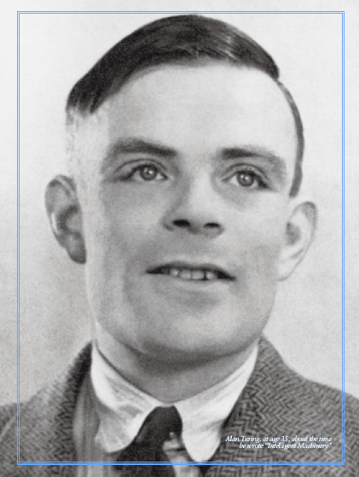
Turing Test: Alan Turing (1950)
Turing was a logician, cryptographer, and mathematician, and the first computer scientist. His theories about computation are the foundation of modern computing. (Textbook, pp.11)
The first to discuss the idea of a “thinking machine” and proposed ways in which we could test whether machines can “think” or at least simulate thinking. The ability to imitate the capacities of the human brain via computation. From “Can machines think?" to "Can machines do what we (as thinking entities) can do?
Turing Test (imitation game)
This test aimed to test a machine’s potential to show intelligent behaviour.
It aimed to assess a human’s ability to differentiate between human and machine intelligence. A machine passes the Turing test if humans fail to recognize between the two.
3 players: an interrogator, a human, and a machine separated from one another
Goal: for the interrogator to discriminate between machine and human through a series of queries using natural language

Slide 5
Chatterbots (Intelligent Agents)
Computational systems based on algorithms that can process complex and large amounts of data.
Example of ELIZA developed by Joseph Wisenbaum in 1966, which could simulate a psychotherapist
Invited students and colleagues to test it out;
Some formed emotional attachments to it, sharing personal details of their life, even after being told it was a machine, some even did not believe him;
Wisenbaum was highly surprised and disturbed by these results, called it “delusional thinking” and decided to write about the danger of such programs;
LET”S TRY IT OUT: https://www.masswerk.at/elizabot/eliza.html

Slide 6
ELIZA: Example
Men are all alike.
ELIZA: IN WHAT WAY?
They're always bugging us about something or other.
ELIZA: CAN YOU THINK OF A SPECIFIC EXAMPLE?
Well, my boyfriend made me come here.
ELIZA: YOUR BOYFRIEND MADE YOU COME HERE
He says I'm depressed much of the time.
ELIZA: I AM SORRY TO HEAR YOU ARE DEPRESSED
It's true. I am unhappy
ELIZA: DO YOU THINK COMING HERE WILL HELP YOU NOT TO BE UNHAPPY
I need some help, that much seems certain.

Slide 7
Mitsuku Chatbot
Developed by Steve Worswick
Web-based chatterbot
-runner-up in the 2017 Loebner prize competition
Let’s try it: https://www.pandorabots.com/mitsuku/
See any differences?

Slide 8
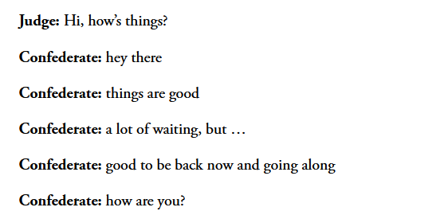
The most human human
Brian Christian acted as one of the ‘humans’ during a Turing test. (Loebner prize competition)
He won the prize for “most human human” – which means he was most likely to be identified as human and least likely to be identified as a computer by the judges he spoke to.
What is the secret to sounding human? His answer: the rhythm of flow of regular conversation – that just can’t be programmed into a machine (yet).
Notes:
https://www.theatlantic.com/magazine/archive/2011/03/mind-vs-machine/308386/
See Robert Stephens’ portfolio for more

Slide 9
Human to human vs computer to human

Slide 10
Problemsonversation so HARD for machines?
One of the problems is that machines find it incredibly difficult to deal with figuring out the context of a conversation.
How can you pre-program a computer to anticipate the nearly infinite possibilities of expression in language, such as irony?
Common sense
Source: Movie “Reality Bites”

Slide 11
So, can AI “think”?
Depends what we mean by “think”
-can make connections/associations fast, sometimes faster than humans
-can solve equations/problems
-can imitate empathy and other emotions (to some extent)
But… do they think like we do?....not yet
+ lack of consciousness ( a whole other discussion)

Slide 12
Activity: Mental Health App Woebot
Download this app which goal is to help you with your mental health. You will need to use it at least 3 times in the next 3 weeks.
1. Take note of how many times you used it in the next 3 weeks (# times per week, how long)
2. Give your impressions (what worked for you, did not, etc.,)
3. How would you improve it
4. Link to Lecture 3 about AI and the Turing test (would it pass the Turing test)?
Notes:
https://woebothealth.com/

Slide 13
Activity: Object Recognition
How a computer sees, ability to recognize objects (e.g., facial recognition)
AI Pictionary: https://quickdraw.withgoogle.com/#
Q1. Tell me how many of your drawings the AI system was able to recognize.
Q2. Once you are done, click on one of your drawings to see how the AI system was able to recognize your drawing. What other images did it link your drawing to?

