Slide 1

Social Problems: Sociology, Technology and Artificial Intelligence
Applying Sociological Imagination to Innovation
Image:
ghananewsonline.com
Professor: Jennifer Sigouin, PhD
Lecture: Feminism, Technology and AI

Slide 2

Feminist Theories
Feminism in General
Women’s experiences differ from men in the same situation
Women experience less privilege than men
Women and men should be social & political equals

Slide 3
Chapter 8
Gendered Technology

Slide 4
AI Assistant
If you have Siri, Cortana, Alexa or any other virtual assistant, try it now. What do you notice about the voice?

Slide 5
Gender and Technology
In the study of technology, scholars tend to disregard gender as an important subject of study, in particular
Technologies are often treated as neutral objects as though they are designed with neither a specific gender or person in mind
Technologies are perceived as impacting women and men equally
Debates around gender issues start after the design of a tool is completed, instead of during development

Slide 6
Women’s Liberation vs. Women’s Oppression
Women’s liberation view:
  Supporting fertility choices (e.g., Fitbit with period tracker)
  Easing the burden of household work
  Creating alternative, flexible work environments particularly suited for women

Slide 7
Women’s Liberation vs. Women’s Oppression, cont’d
Women’s inclusion view:
advocates that women need to be greater integrated into the technology debate
Women need to be active participants and creators

Slide 8
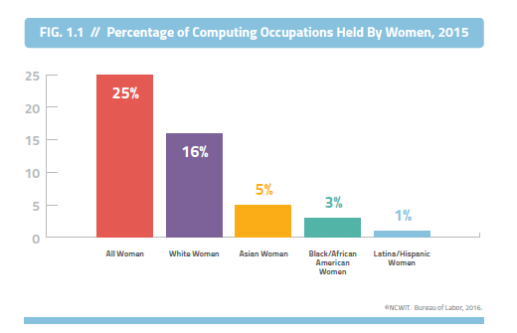
Women in STEM fields: Statistics
Women are still underrepresented in STEM fields (Science, Technology, Engineering, Computer Science):
Women accounted for 23% of those who graduated from engineering and 30% of those who graduated from mathematics and computer science programs (Statistics Canada, 2011)
Women make up 47 percent of all employed adults in the U.S., but as of 2015, they hold only 25 percent of computing roles (Women in Tech, U.S., 2015)
Notes:
https://www150.statcan.gc.ca/n1/pub/75-006-x/2013001/article/11874-eng.htm
https://www.ncwit.org/resources/women-tech-facts-2016-update

Slide 9
Women in IT-Related Fields, cont’d
Why do we see a trend toward fewer women choosing IT careers, when this sector is growing and providing increasingly well-paid employment?
Understanding this trend is difficult
Evidence consistently shows that women are using a wide range of technologies in their daily life

Slide 10
Women in IT-Related Fields, cont’d
Why are more women not choosing IT careers?
Gendered socialization
Gendered roles/school departments:
Toxic workplace environments

Slide 11
Ubisoft scandal
Using the article, list all the inappropriate behaviors that was listed. Explain why these behaviors are inappropriate, using key terms associated with Feminism (e.g., sexism).
Notes:
https://www.bloomberg.com/news/articles/2020-07-21/ubisoft-sexual-misconduct-scandal-harassment-sexism-and-abuse

Slide 12

Women in IT-Related Fields, cont’d
There have been several attempts to make technology, and coding in particular, more inclusive for women

Slide 13
AI and Gender Inequality

Slide 14
Gendered Language And Its Impact On Hiring
Studies show that gender-coded words can significantly reduce the number of women applying to open positions (Gaucher et al, 2011).
E.g Buffer realized that less than 2% of its candidates for developer positions were women because they used the word “hacker”in their description
Avoid gender-coded words, like “rockstar,” “ninja,” and “dominate”, “leader”
gendered wording as an institutional-level mechanism of inequality maintenance
Textio Hire—an online tool that analyzes job descriptions and suggests improvements to make the language more appealing to all applicants
Notes:
Gaucher et al. (2011) Evidence That Gendered Wording in Job Advertisements Exists and
Sustains Gender Inequality.

Slide 15
Technology and the Body

Slide 16

Technology and the Body
How does the body come
into play in different social
media sites?
How about Instagram?
  Idealized front-stage behaviors
  Mental health issues
Apps
  Calorie Mama AI
  https://caloriemama.ai/

Slide 17
Technology as a tool for gender equality

Slide 18
Use of Social Media
The hashtag #MeToo, a hashtag first used by African American women’s rights activist Tarana Burke in 2006, has received global attention.
The significant scale, volume, and endurance of #MeToo makes it stand out from other online conversations about misogyny and violence against women

Slide 19

Feminism: The Tampon Run
Notes:
Developed by 2 high school girls who met at Summer camp for coding. Andrea Gonzales and Sophie Houser

Slide 20
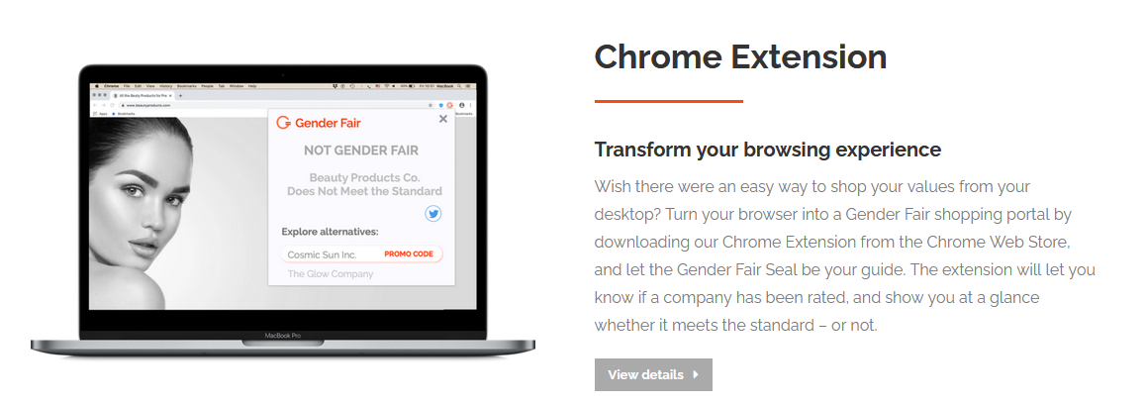
Feminism: Gender Fair App
Notes:
http://www.genderfair.com/

Slide 21
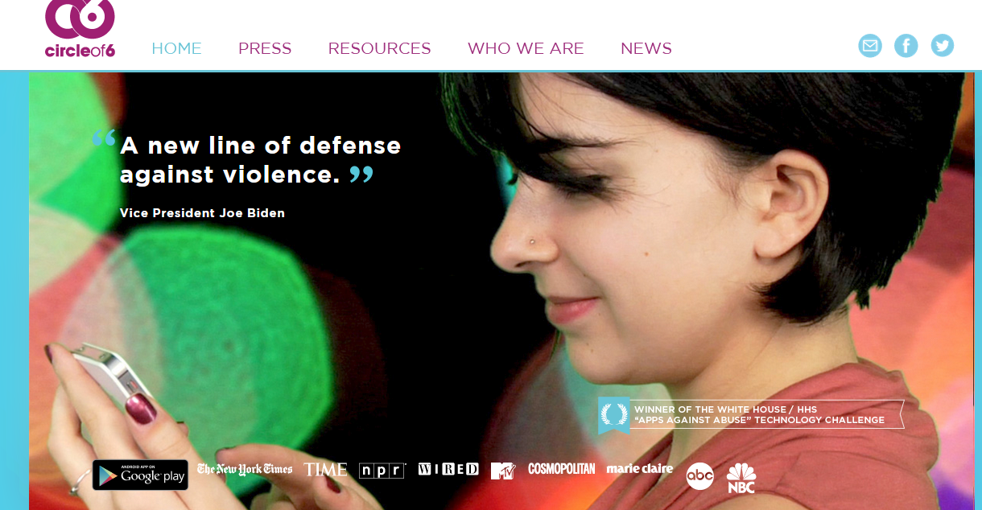
Safety
Circle of 6 app
Notes:
https://www.circleof6app.com/

