Slide 1
Philosophy of Mind
PHIL 306 – Fall 2016
McGill University
R. Stephens

Slide 2
Plan for today
The extended mind thesis – Clark & Chalmers
Chalmers’ foreword to Clark’s book
Objections and replies...
(Next class) Clark on embodiment, along with Gallagher & Zahavi

Slide 3
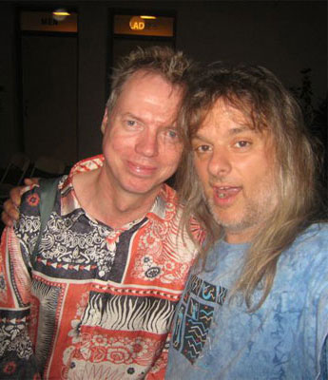
The Extended Mind thesis
Chalmers’ foreword to Clark’s book reiterates the main point of the EM thesis
A parity principle:
[I]f a process in the world works in a way that we should count as a cognitive process if it were done in the head, then we should count it as a cognitive process all the same. (ix)
Friends joke that I should get the iPhone implanted into my brain. But if Andy Clark is right, all this would do is speed up the processing and free up my hands. The iPhone is part of my mind already… My iPhone is not my tool, or at least it is not wholly my tool. Parts of it have become parts of me. This is the thesis of the extended mind: when parts of the environment are coupled to the brain in the right way, they become parts of the mind. (ix-x)

Slide 4
The Extended Mind thesis
The case of belief: Otto and Inga (pp. 12-13)
Inga wants to go to the museum.
She remembers that it is on 53rd St.
So she goes to 53rd St.
She has a belief that it was there, stored in memory, which she accessed as needed.
Otto has Alzheimer’s, so he keeps a notebook to jot down everything he would otherwise forget.
He too wants to go to the museum.
He checks his notebook and it says the museum is on 53rd St.
So he goes to 53rd street.
He similarly has a belief – the only difference it where it was stored...

Slide 5
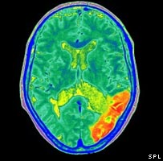
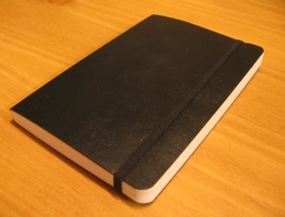
The Extended Mind thesis
The cases are entirely analogous: the notebook plays for Otto the same role that memory plays for Inga. The information in the notebook functions just like the information [in Inga’s memory]; it just happens that this information lies outside the skin.

Slide 6
The Extended Mind thesis
What about socially extended cognition? Could my mental states be partly constituted by the states of other thinkers? We see no reason why not.

Slide 7
The Extended Mind thesis
An objection from Fodor:
This suggests that if Otto loses his phone, Inga loses part of her mind... Does that sound plausible?

Slide 8
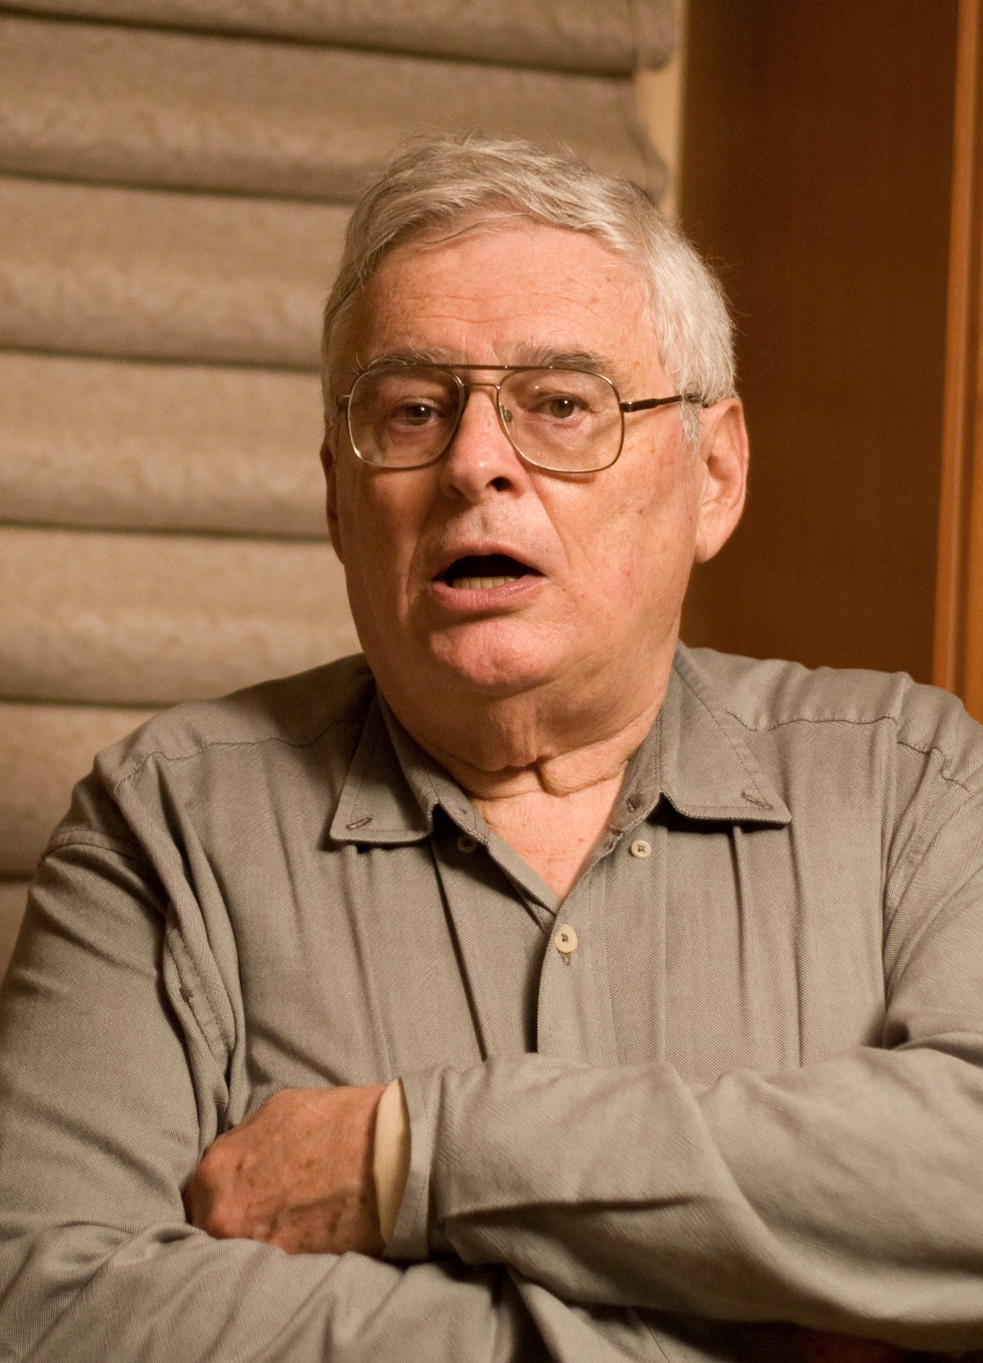
The Extended Mind thesis
Some objections:
Fodor’s complaint -
Does Inga ‘consult’ her memory like Otto ‘consults’ his book?
Otto remembers/believes the info is in his notebook. And presumably this memory/belief (that the info is in the notebook) is inside Otto’s head. (The one thing he remembers?)
Q: Does Inga = Otto, does she similarly remember that her info is in her head?
If so, then she needs to ‘consult’ that memory first.
But then, that memory needs a memory that it is in her head (and so on)
Is there a lurking INFINITE REGRESS here?

Slide 9
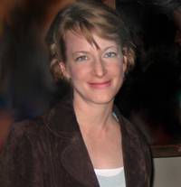
The Extended Mind thesis
Some objections:
Brie Gertler’s complaint -
There will be a proliferation of action attributable to a coupled system
What if Otto’s notebook were a hard drive, implanted in a semi-autonomous robot?
If the robot acts on Otto’s beliefs and desires (as recorded) are the robot’s actions Otto’s actions? (E.g., bakes some banana bread)

Slide 10
Supersizing the Mind
Chalmers discusses the scope of EM:
What about extended consciousness?
Chalmers says why not? Perhaps “low-bandwidth” external coupling like the notebook won’t count, but we could imagine other sorts of coupled systems...
I think there is no principled reason why the physical basis of consciousness could not be extended in a similar way. It is probably so extended in some possible worlds: one could imagine that some of the neural correlates of consciousness are replaced by a module on one’s belt, for example. There may even be worlds where what is perceived in the environment is itself a direct element of consciousness... (xiv)

Slide 11
Supersizing the Mind
Chalmers discusses the scope of EM:
What does EM tell us about philosophy of mind?
Chalmers suggests EM is pretty ecumenical – it maybe demands a basic sort of functionalism in some respects, but it doesn’t force you to pick between materialism/dualism, computationalism/non-computationalism, etc.
I do not think that the extended mind thesis requires much in the way of theoretical presupposition at all. Instead, it is an independently attractive view of the mental. (xvi)

Slide 12
Reading for next time
Preview of the next reading assignment: extended cognition
Zahavi & Gallagher – Ch & of The Phenomenalogical Mind
[supp] Rodney Brooks – Intelligence without Reason

