Slide 1
Soul Train, “the line”, and black performance in America
Hanif Abdurraqib

Slide 2
Soul Train
https://www.youtube.com/watch?v=lODBVM802H8 (general)
https://www.youtube.com/watch?v=AD4GQ-NGgNs (beat it)
https://www.youtube.com/watch?v=5P-TXxoWTSE (don’t stop til you get enough)
https://www.youtube.com/watch?v=k3bt_NT21DE (Rosie Perez compilation)
https://www.youtube.com/watch?v=rrkfJ-HsPfA (for cultural continuity, Rosie Perez’s dance sequence to Public Enemy’s “Fight the Power,” in the opening credits of Spike Lee’s groundbreaking Do The Right Thing (1989))

Slide 3
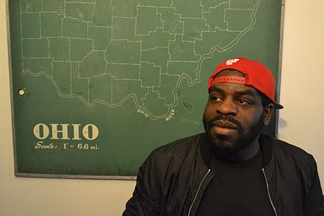
Hanif Abdurraqib is an American poet, essayist, and cultural critic. He is the author of numerous poetry and essay collections. He was awarded the Andrew Carnegie Medal for Excellencw in 2022 and won the MacArthur Genius Award in 2021.

Slide 4
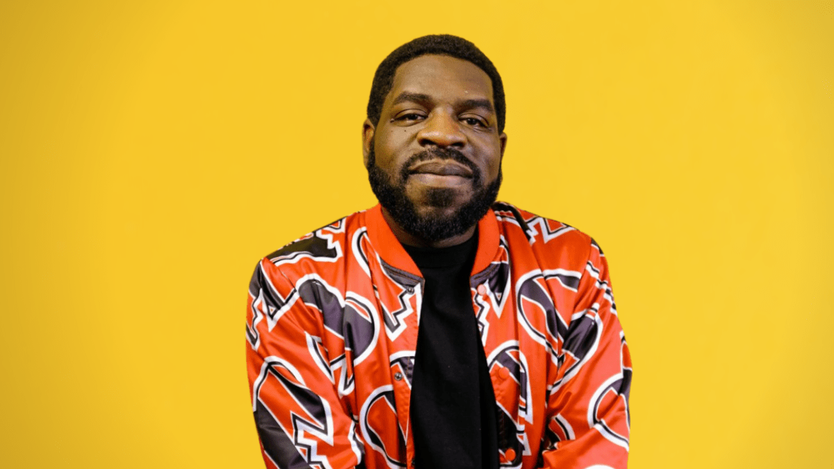
What does Hanif Abdurraqib mean when he writes: “Everyone putting on different masks for different worlds and calling it freedom” (pg. 91?)

Slide 5
Read excerpts from A Little Devil In America:
pgs. 89-91
What does Abdurraqib mean when he writes: “[jazz] was a bridge bringing [his father] back to a more familiar self” (89)?
What is code-switching generally (specifically described as “talking white” in the text)?
According to Abdurraqib, is code-switching good, bad, or both?

Slide 6
In small groups, answer the following question. Hand in your answers at the end of class. (40 marks)
What are the examples of the ways that the mainstream circulation of Black bodies perpetuates community and joy? (10 marks)
What are some of the ways that “watching” racialized peoples contributes to our understanding of race? (10 marks)
Do you think visual images and videos can create or change “fixed ideas”? (10 marks)
What does the wide consumption of Soul Train episodes do to our fixed ideas about the black community? (10 marks)

Slide 7
Should the image of Emmett Till’s brutalized body come with a content warning? What should the content warning say?
EMMETT LOUIS TILL (July 25, 1941 to August 28, 1955) was a 14 year old African American boy who was abducted, tortured and lynched in Mississippi in 1955, after being accused of offending a white woman. Despite the barbarism of his illegal murder, his killers were acquitted. Till’s mother, Mamie Till Bradley, decided to keep her son’s coffin open during the funeral to expose the world to her son’s mutilated body. Images of Emmett Till’s body were seen across the U.S. through newspaper coverage. Much like George Floyd’s murder catalyzed renewed support for and anti-racist and anti-police brutality activism in recent times, Till’s murder ushered in a new and historically significant phase in the civil rights movement.

