Slide 1
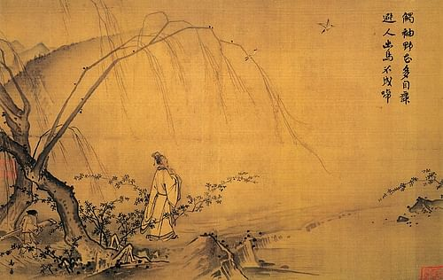
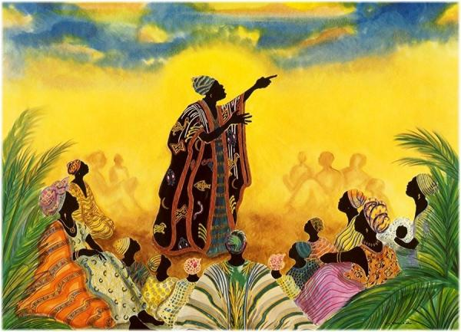
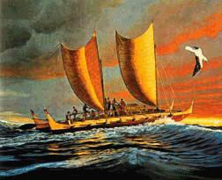
Charles w. mills and THE RACIAL BIAS OF WESTERN PHILOSOPHY

Slide 2
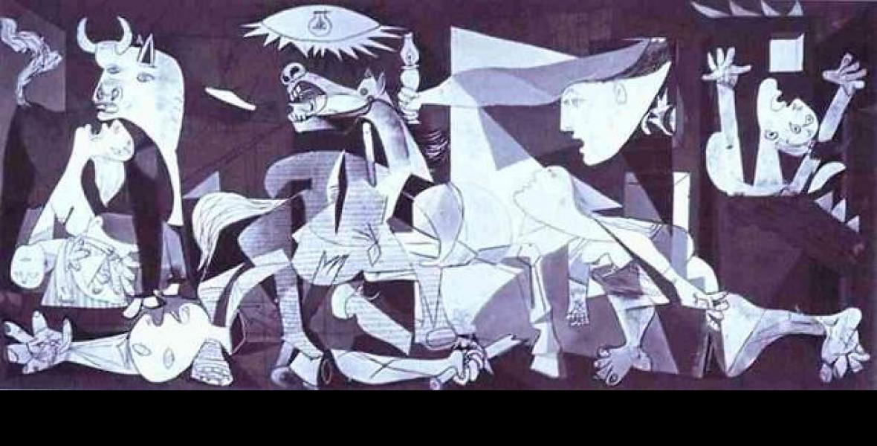
Positionality
The way social position (e.g., race, gender, class, ability) shapes identity in society.
What philosophical questions does this concept relate to?
On a piece of paper, take a minute write down three things about your identity that shape your social position (how much power, recognition, possibility you have).
Let’s share and compare.

Slide 3
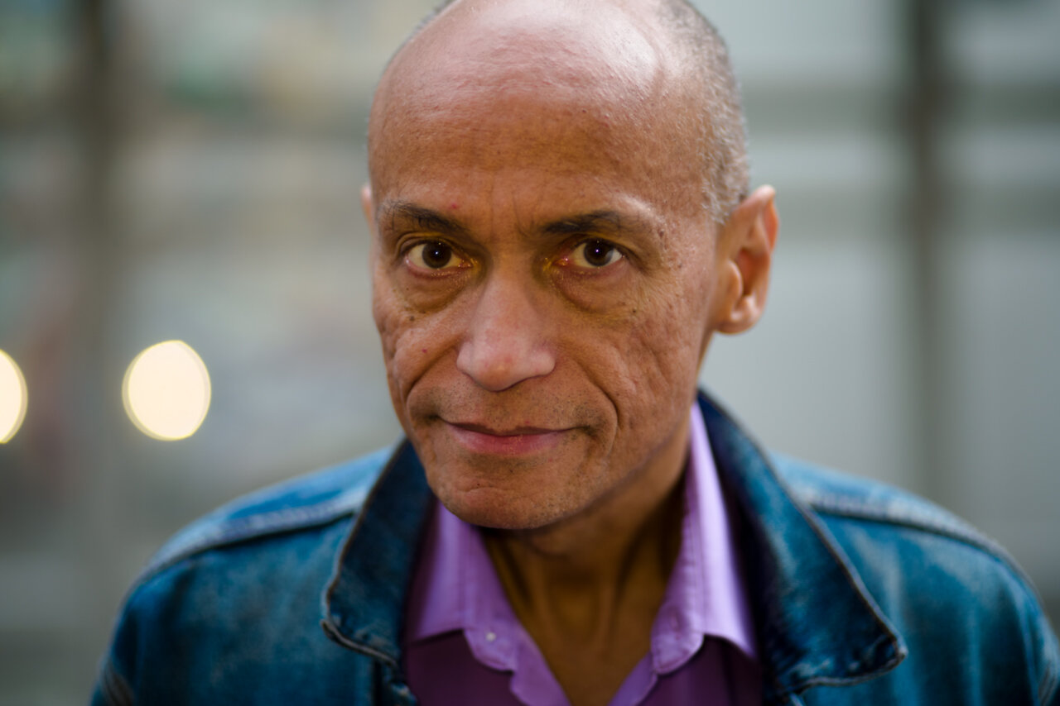
Charles W. Mills
Charles Wade Mills is a Jamaican-American philosopher. He is known for his work in social and political philosophy, particularly in oppositional political theory as centered on class, gender, and race. Mills is Distinguished Professor of Philosophy at The Graduate Center, City University of New York, in New York City. Mills's main research interests are in political theory (radical and oppositional), particularly around issues of social class, gender, and race. He has published numerous articles on Marxism, critical race theory, and African-American philosophy.

Slide 4
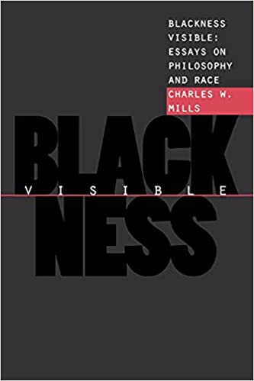
Read orally: excerpt from pg. 2 Blackness Visible
What is the “schizophrenic relationship” women often have with classical philosophy, and why do they have it?
Also, why does Mills begin with the gender parallel to build his argument?

Slide 5
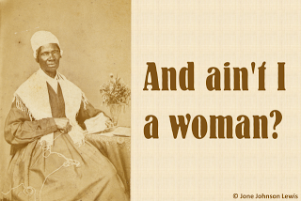
Read orally: excerpt from pg. 3 Blackness Visible
What, according to Mills, is the difference between women and blacks in classical philosophy?
Why does he say that black silence and invisibility is of a different kind?

Slide 6
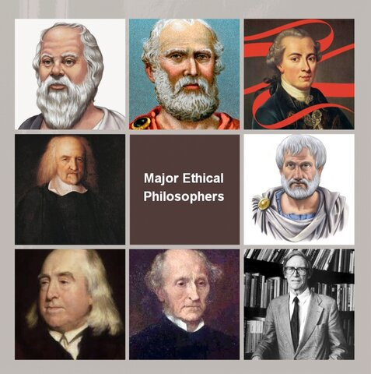
Read orally: excerpt from pg. 4 Blackness Visible
What is the source of the impatience or indifference of black students to moral philosophy?
What is the “pretense” that Mills describes?

Slide 7
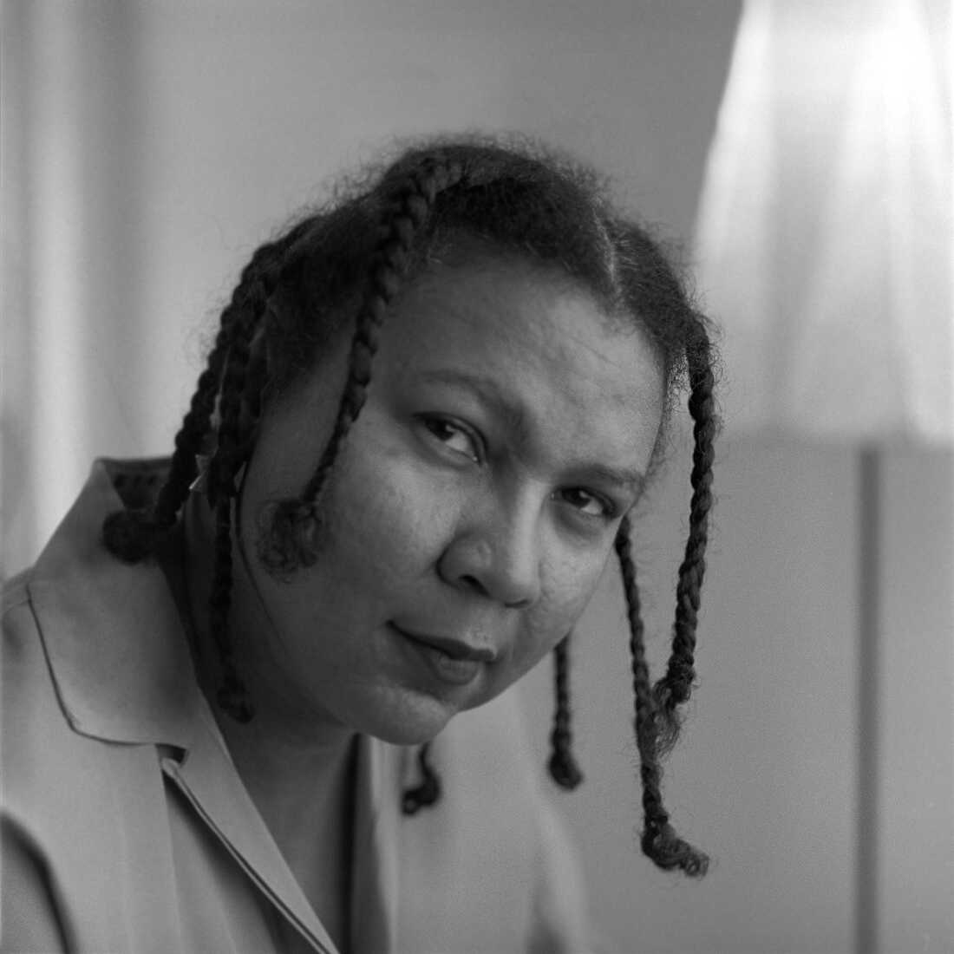
Read orally: excerpt from pg. 5 Blackness Visible
What does the claim that “abstractness… is covertly particularistic and concrete” mean?
What is Mills’s critique of classical philosophy?
Notes:
The concrete reality of the BIPOC experience can never by represented abstractly.
What “abstraction” really means is “the standard view”. It is a way to formally shave off the edges of a thought, which really means, according to Mills, the exclusion of all views other than the standard one.

Slide 8
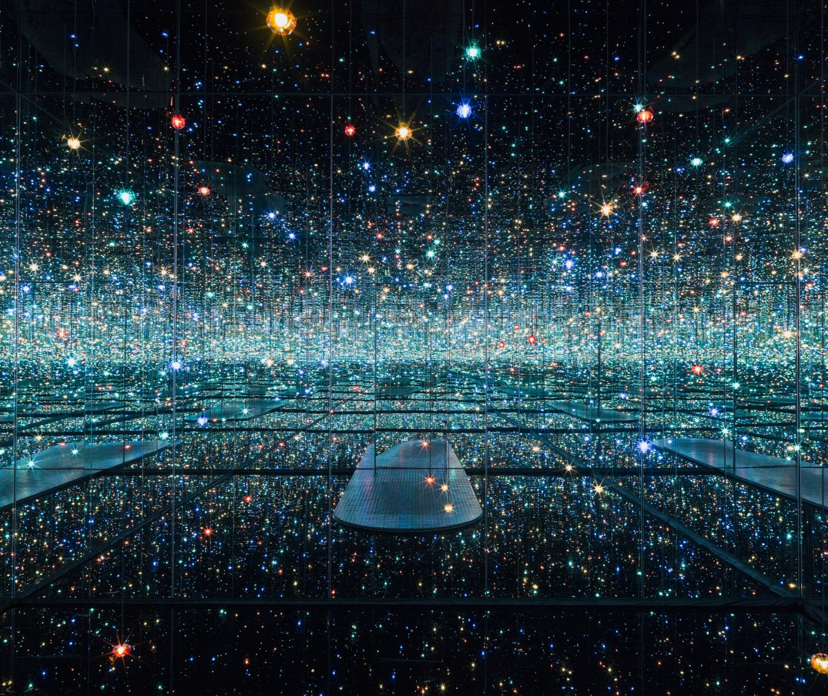
In-class assignment (done in groups) Going back to Nietzsche and perspectivism: 30 marks 20 minutes (submit in class)
Nietzsche argues that truth is revealed when we understand that “[t]here is only perspectival seeing, only perspectival “knowing”; and the more affects we allow to speak about a matter, the more eyes, different eyes, we know how to bring to bear on one and the same matter, that much more complete will our “concept” of this matter, our “objectivity” be.” (85, On the Genealogy of Morality, Hackett 1998)
1) Is perspectivism a perspective? If so, what does that mean? Explain your answer. (5 marks)
2) (20 marks)
a) Is perspectivism an abstraction (as Mills describes abstraction)?
b) In which case, is perspectivism part of, as Mills describes it, the racist history of Western philosophy?
c) Make an argument. Show proof by using the primary sources (i.e., Nietzsche and Mills)
Yayoi Kusama

Slide 9
The Racial Bias of Western Philosophy 30 marks Graded for content Due: Monday, April 4, 2022 Submit in class Can be done in groups
Let’s say Charles W. Mills is right, and the history of Western philosophy pretends to be universal while being covertly particularistic. Every philosopher we’ve read is part of the Western canon. Make an argument (by showing proof from the primary sources) that at least two philosophers we’ve read are part of the problem, as Mills sees it. In other words, show proof that at least two philosophers we’ve read are part of the racially biased history of Western philosophy. /20
For each philosopher, say whether you agree or disagree with your initial argument (make a supporting argument or a counter-argument). /10

Slide 10
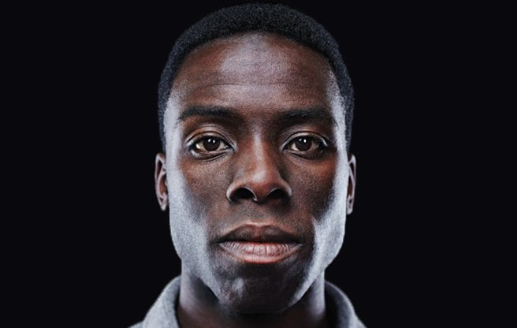
Desmond Cole
Desmond Cole is a Canadian journalist, activist, author, and broadcaster who lives in Toronto, Ontario. Cole hosts a weekly radio program on Newstalk 1010. Cole's activism has received national attention, specifically on the issues of police carding, racial discrimination, and dismantling systemic racism. Cole was the subject of a 2017 CBC Television documentary, The Skin We’re In. His first book, The Skin We're In: A Year of Black Resistance and Power, was released in January 2020.
Cole's first book, The Skin We’re In: A Year of Black Resistance and Power, was announced in 2019 and released on 28 January 2020. The books focuses on 2017 and chronicles a year "in the struggle against racism in Canada."
In the aftermath of the death of Regis Korchinski-Paquet, Cole argued for the defunding of the Toronto Police and the redistribution of funds to mental health services and initiatives to address poverty and systemic racism.

Slide 11
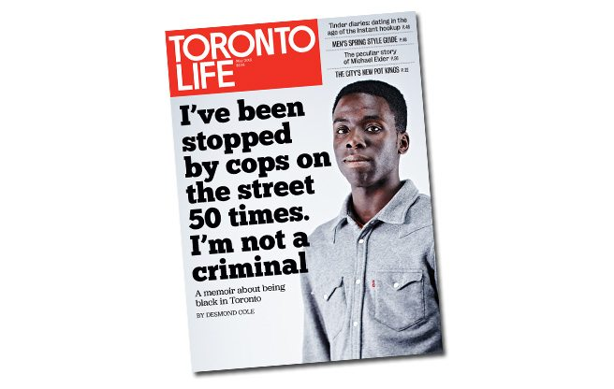
A general discussion of the Desmond Cole article, “The Skin I’m In”
Was it a surprise to learn that Desmond Cole’s experience was in Canada?
Pgs. 4-5: “My skin is the deep brown of a well-worn penny. My eyes are the same shade as my complexion, but they light up amber in the sun, like a glass of whiskey. On a good day, I like the way I look. At other times, particularly when people point out how dark I am, I want to slip through a crack in the ground and disappear. White people often go out of their way to say they don’t see colour when they look at me—in those moments, I’m tempted to recommend an optometrist. I know they’re just expressing a desire for equality, but I don’t want to be erased in the process. When I walk down the street, I find myself imagining that strangers view me with suspicion and fear. This phenomenon is what the African-American writer and activist W. E. B. Du Bois described as “double-consciousness”: how blacks experience reality through their own eyes and through the eyes of a society that prejudges them.”
Pg. 12: “After years of being stopped by police, I’ve started to internalize their scrutiny.”
How does this relate to Sartre’s discussion of self-consciousness (think specifically of his discussion of shame)?
How does this relate to Nietzsche’s three basic perspectives?
How does discrimination change the behaviour of the discriminated (think of the Observer’s Paradox)?

